Slide 1

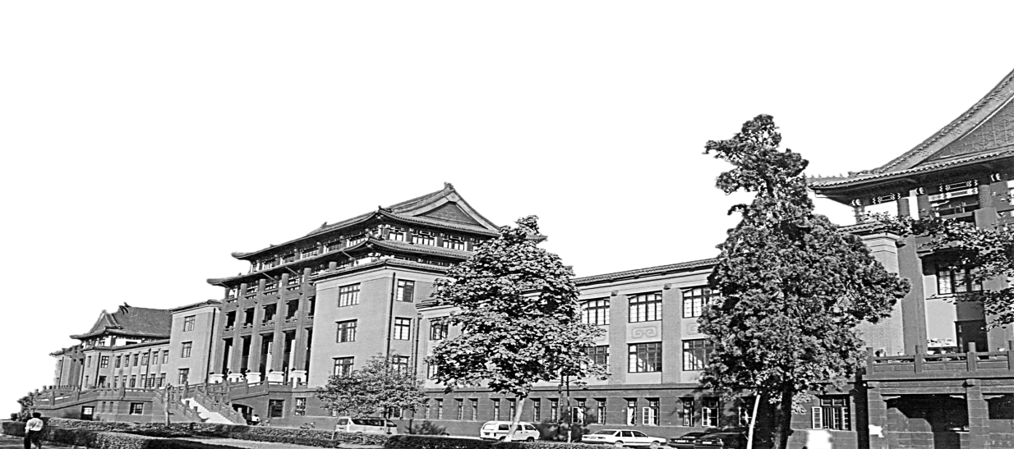
VVBP-Tensor in the FBP Algorithm: Its Properties and Application in Low-Dose CT Reconstruction
Xi Tao, Hua Zhang, Yongbo Wang, Gang Yan, Dong Zeng, Wufan Chen, and Jianhua Ma
IEEE TRANSACTIONS ON MEDICAL IMAGING 2020
陈祥
2020.12.22

Slide 2
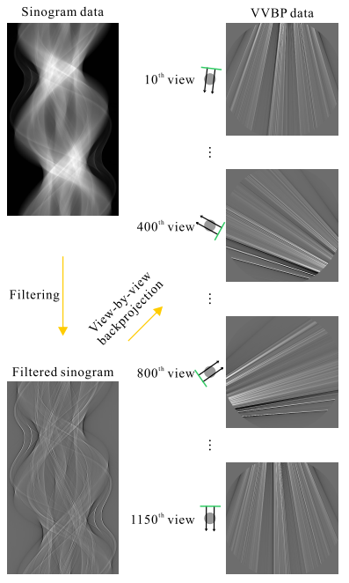
FBP Steps
filtering
2. view-by-view back projection (VVBP)
3. Summing

Slide 3
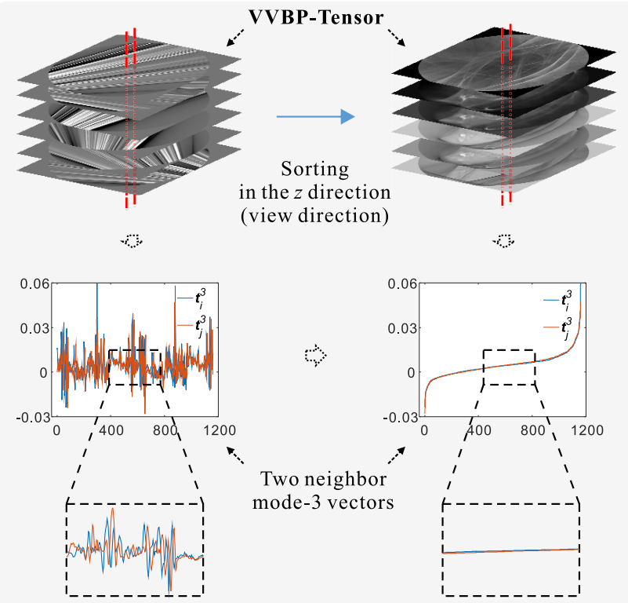
Contributions
1. We analyzed the properties of VVBP-Tensor, including
structural self-similarity, tensor sparsity, and noise statistics.
2. propose an algorithm named VVBP-tSVD to denoise the
VVBP-Tensor.

Slide 4
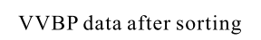
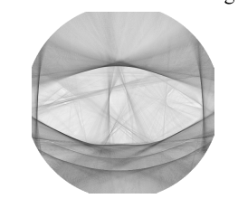
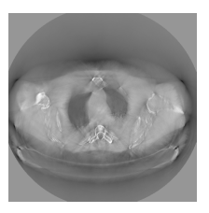
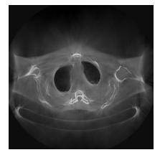
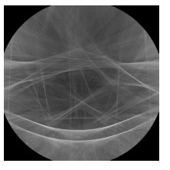
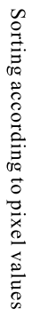
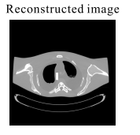
Pipeline of VVBP-Tensor Analysis
linear and invertible

Slide 5
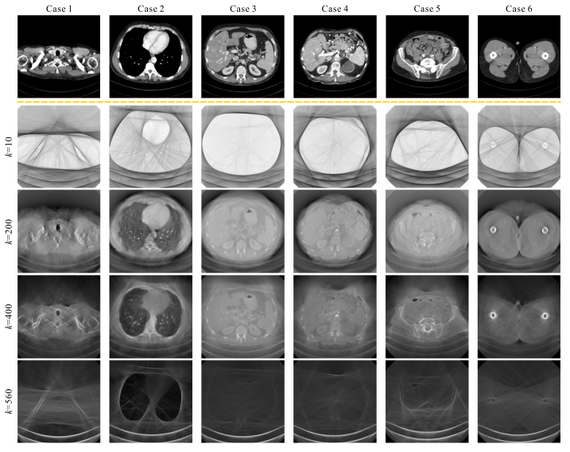
Method
sorted VVBP-Tensors contain rich structures

Slide 6
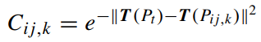
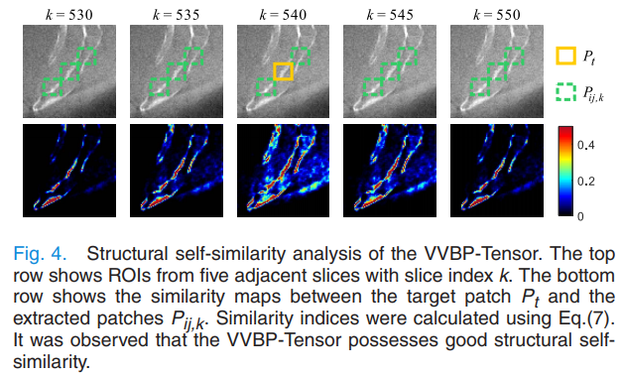
VVBP-Tensor Properties
from five adjacent slices of the phantom VVBP-Tensor and computed their similarity maps
similarity maps: negative Euclidean distance
same structures across different slices
It was observed that the VVBP-Tensor possesses good structural self similarity.

Slide 7
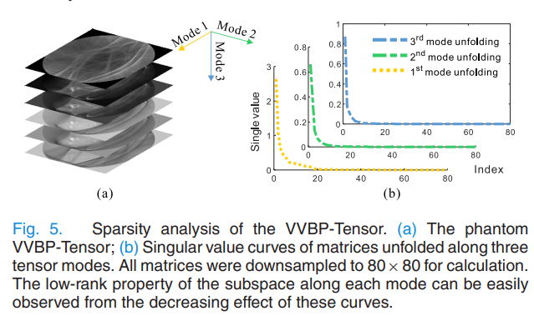
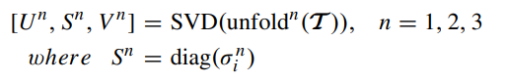
VVBP-Tensor Properties
VVBP-Tensor resides on a low-rank
subspace along each mode and therefore possesses good tensor
sparsity

Slide 8
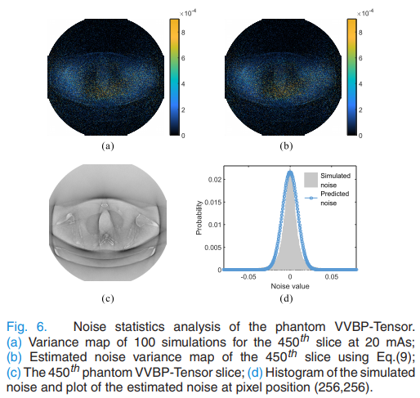
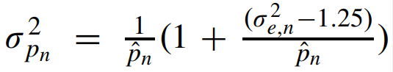
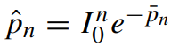
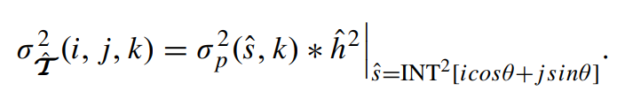
VVBP-Tensor Properties
In previous work
The noise variance at pixel (i, j, k) can be estimated as the squared weighted average of the noise variance of its neighbor pixels

Slide 9
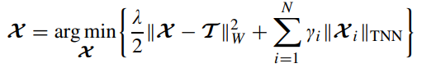
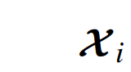
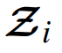
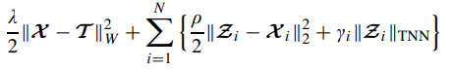
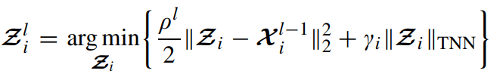
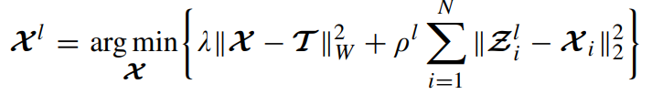
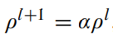
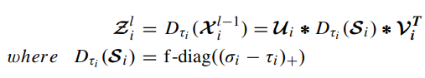
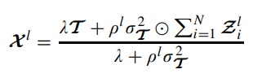
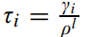
Models
nuclear norm of a tensor
=
half-quadratic splitting

Slide 10
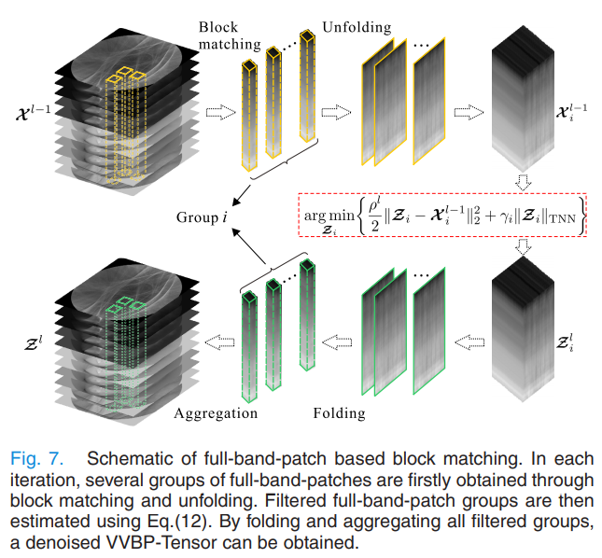
Models

Slide 11
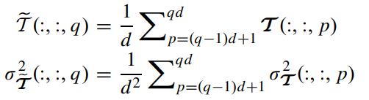
Models
slice-by-slice normalized
the VVBP-Tensors of the phantom and patient data used in this study contain 1160 and 576 slices, respectively
the processing time is greatly reduced while quality of the result is slightly degraded

Slide 12
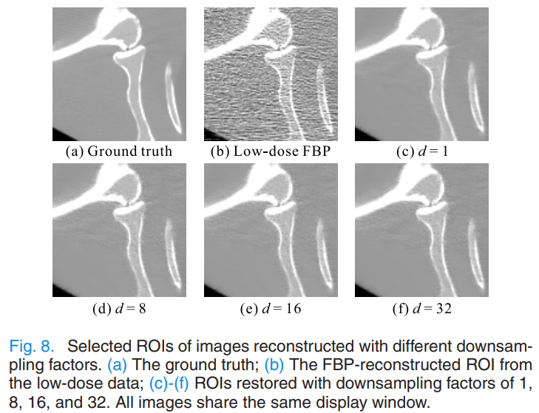
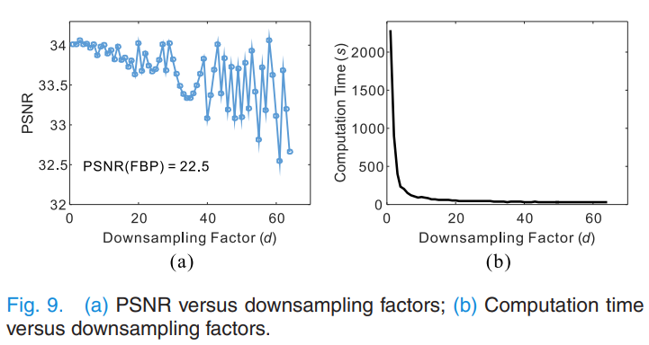
Experiments & Results
Influence of the Down sampling Factor
Down sampling factor was set to 8

Slide 13
Experiments & Results
Datasets: a physical phantom and three patients from the LowDose CT Grand Challenge dataset
physical phantom :One level of tube voltage (120 kVp) and three levels of tube current (17, 40, and 60 mAs) were set.
In addition, a sinogram, which was acquired by averaging 150 repeated measurements at 100 mAs and 120 kVp, was used as the ground truth.
patients datas: data under 1/6- and 1/8-dose levels

Slide 14
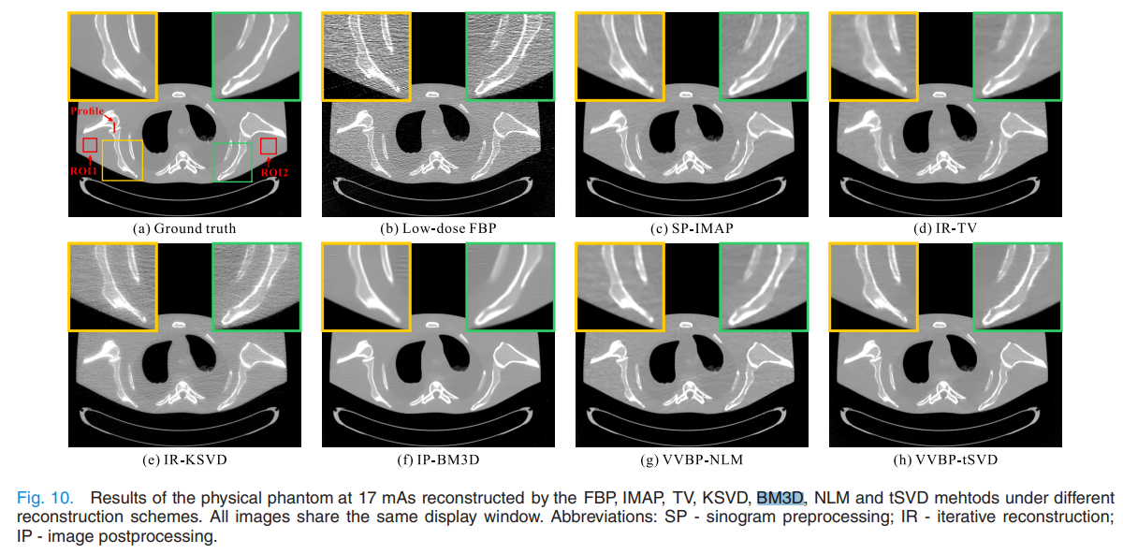
Experiments & Results

Slide 15
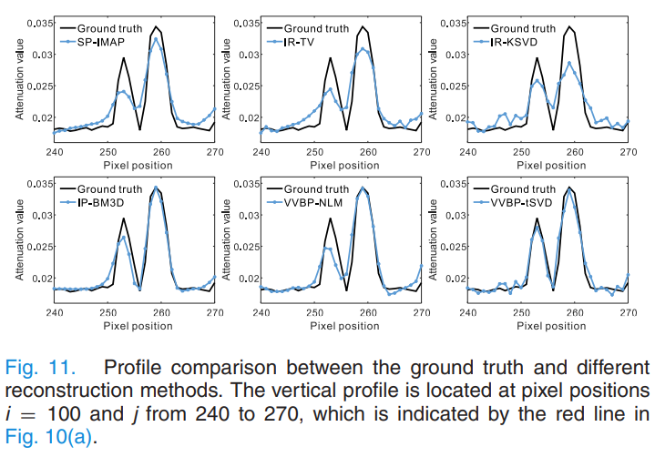
Experiments & Results

Slide 16
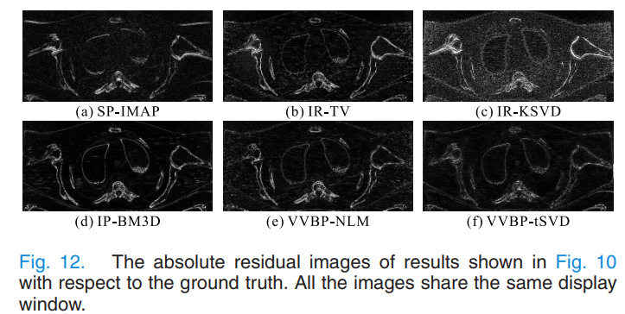
Experiments & Results

Slide 17
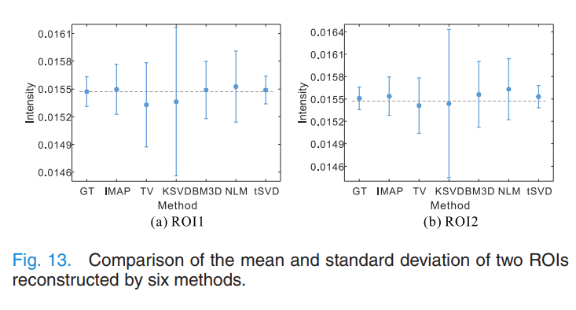
Experiments & Results

Slide 18
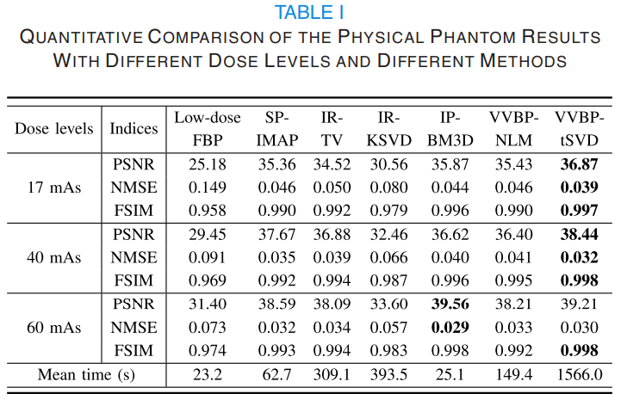
Experiments & Results
NMSE: normalized mean-square error
FSIM: feature similarity

Slide 19
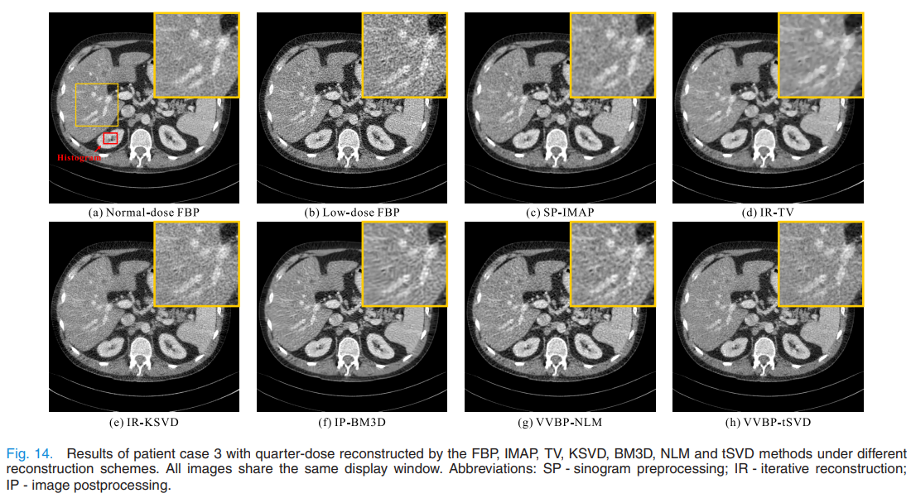
Experiments & Results
Patient Study

Slide 20
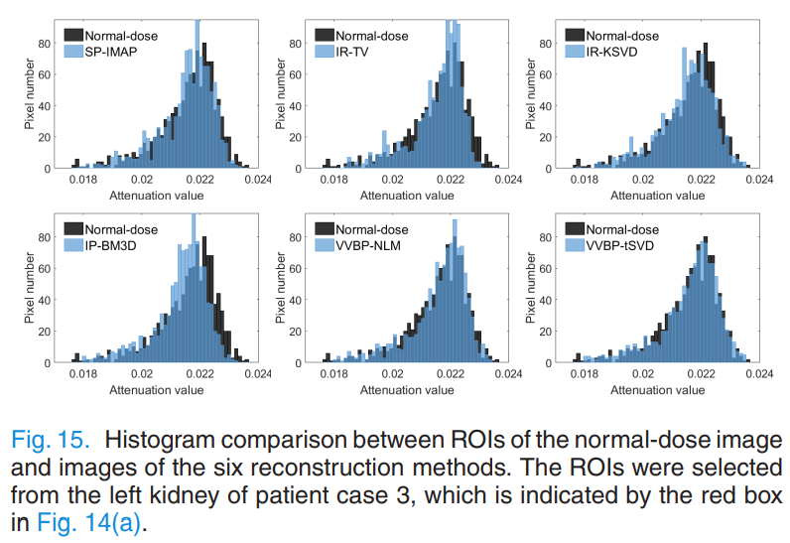
Experiments & Results

Slide 21
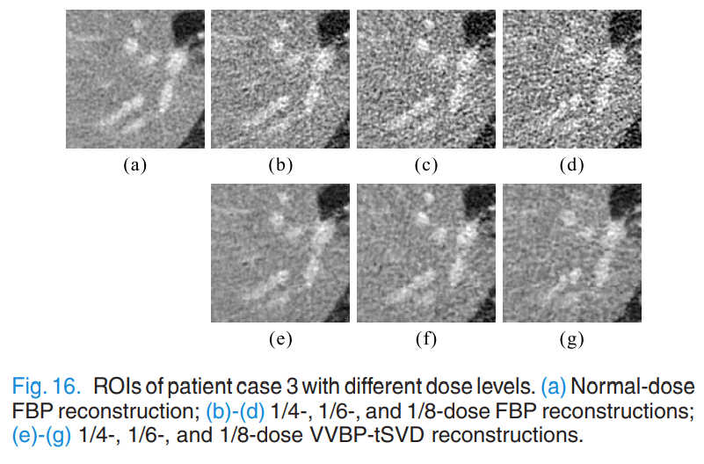
Experiments & Results

Slide 22
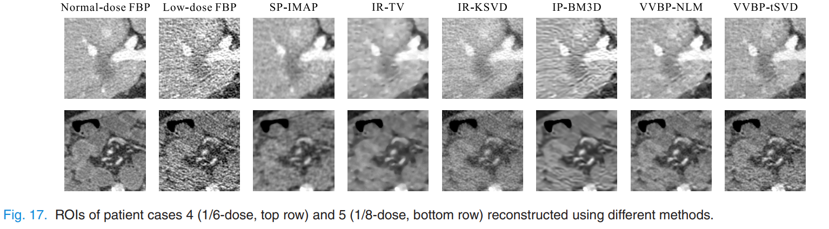
Experiments & Results
Notes:
评价指标：TP:如果预测的细胞中心和ground truth距离小于p（p是数据集里最小的细胞半径）
没有预测到的被记为FN

Slide 23
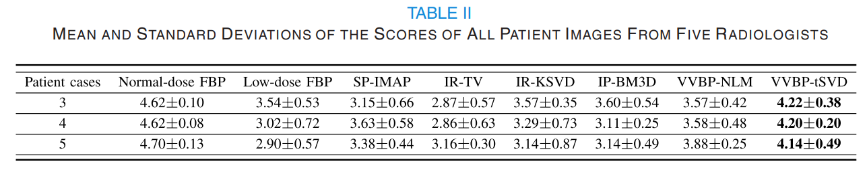
Experiments & Results
Notes:
评价指标：TP:如果预测的细胞中心和ground truth距离小于p（p是数据集里最小的细胞半径）
没有预测到的被记为FN

Slide 24
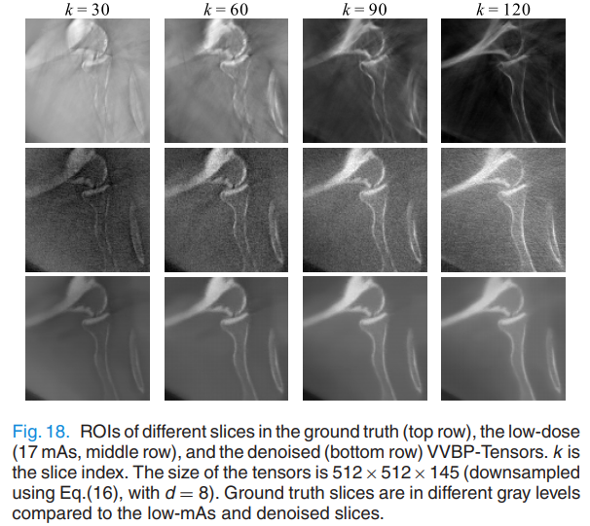
DISCUSSION AND CONCLUSION
the VVBP-Tensors for high-mAs and low-mAs CT from the same object are different.
Reasons:
ramp filter is high-pass filter
the noisy low-mAs sinograms tend to have a wider gray range than their high-mAs counterparts
Therefore, the goal of VVBP-Tensor denoising should be to reduce the noise in low-mAs VVBP Tensor but not to restore it as a high-mAs one
Notes:
评价指标：TP:如果预测的细胞中心和ground truth距离小于p（p是数据集里最小的细胞半径）
没有预测到的被记为FN

Slide 25
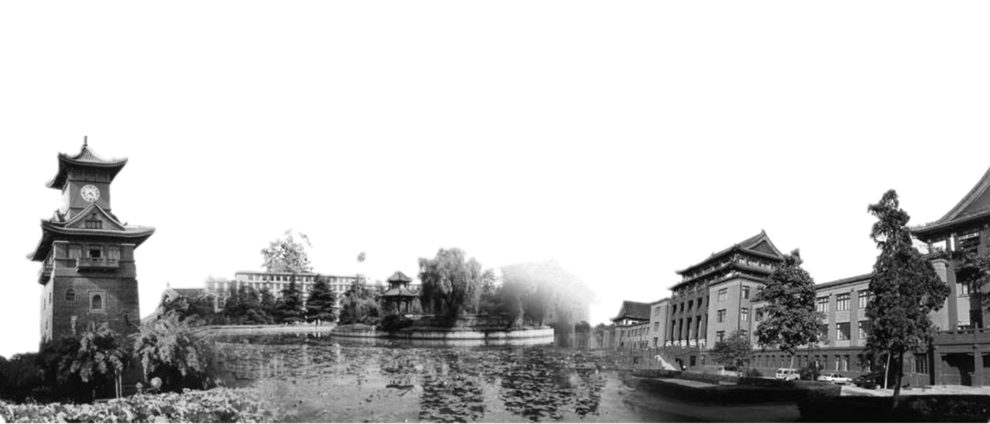
Thank You!

